Slide 1
Classifying German Traffic Signs
Gabriel Silva (85129) & Gonçalo Vítor (85119)
Universidade de Aveiro
DETI
Course: Machine Learning
Professor: Pétia Georgieva

Slide 2
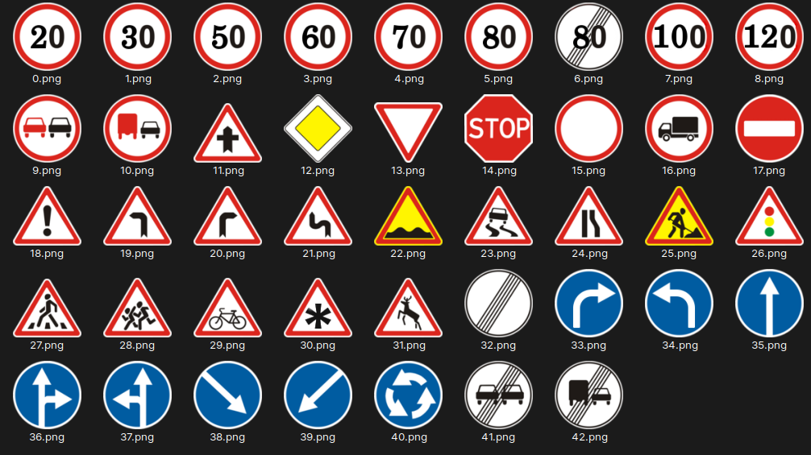
The Data
Used the GTSRB, a dataset made of images of traffic signs.
There are 43 different signs(classes).
The images are distributed in folders. Each folder has the images of a certain class. Each folder is named accordingly.

Slide 3
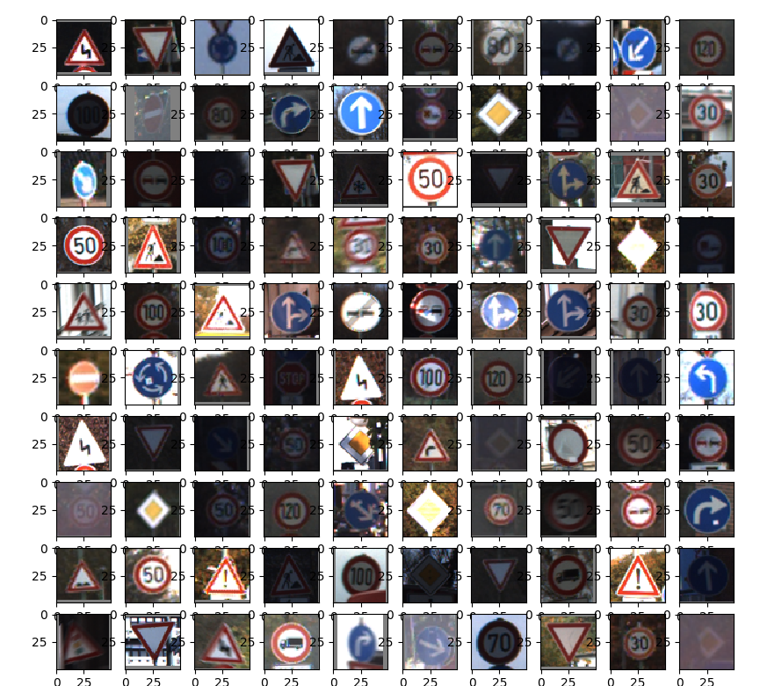
Data Preprocessing
Images are of various sizes which required resizing to a common size.
Images were also scaled.
Only 10% was used.

Slide 4
Models
3 different types of models were used
Logistic Regression
SVM
Neural Network
Model optimization was done using sklearn GridSearchCV, which scores models using cross-validated parameters.

Slide 5
Logistic Regression
Using sklearn LogisticRegression.
lbfgs solver.
Regularization parameter C (the inverse of regularization strength).

Slide 6
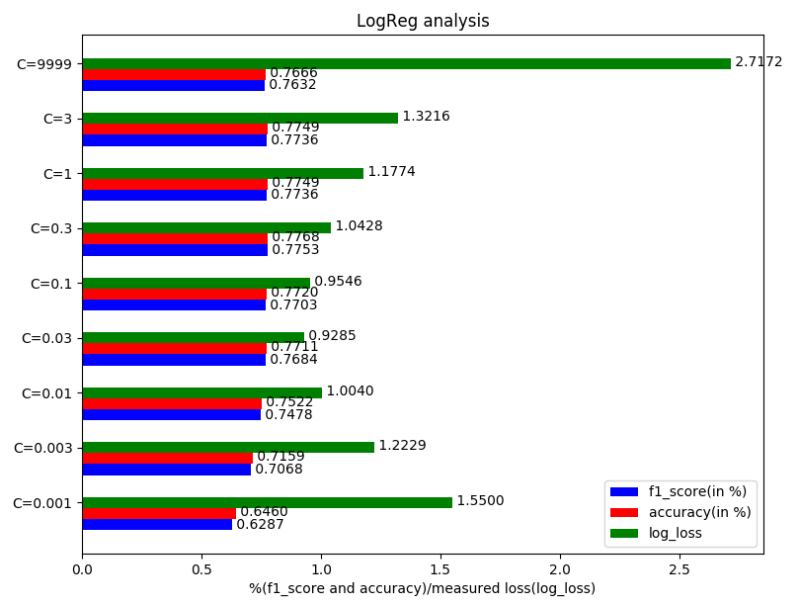

Logistic Regression
Different values of C were tested.
The model that performed the best was the one with C= 0.03.
It’s scores on the test set are:
It took 4 min to train.

Slide 7
SVM
Using sklearn SVC.
Regularization parameter C (the inverse of regularization strength).
Using linear kernel.

Slide 8
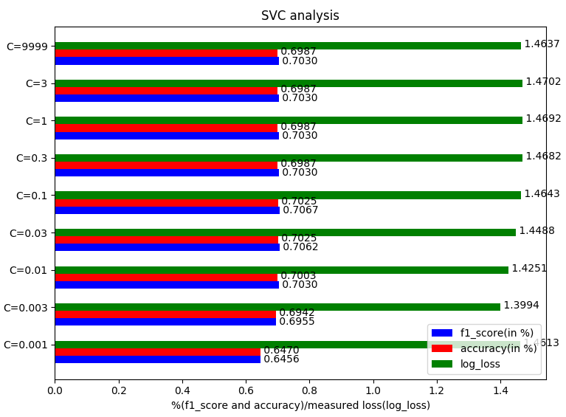

SVM
Different values of C were tested.
The model that performed the best was the one with C= 0.01.
It’s scores on the test set are:
It took 1 min to train.

Slide 9
Neural Network
Using sklearn MLPClassifier.
sgd solver.
Sigmoid activation function.
Only one hidden layer, with 100 neurons.

Slide 10
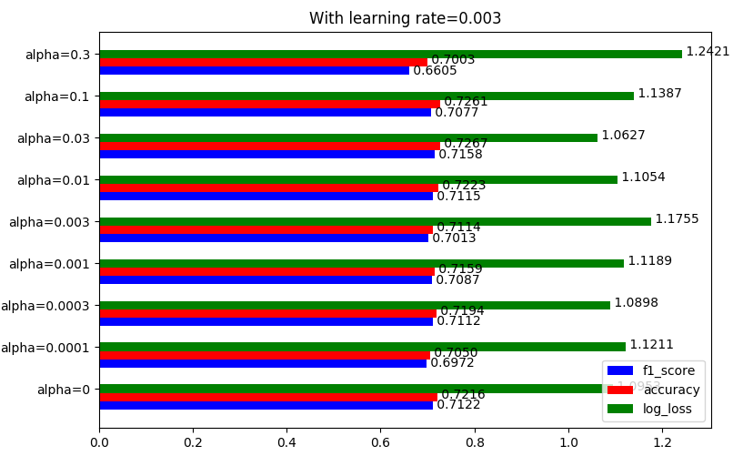
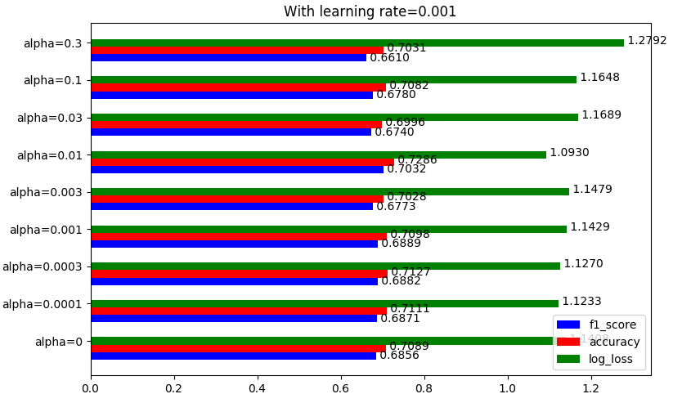
Neural Network
Different values of regularization(alpha) and learning rate were tested.
The best model is the one with alpha=0.03 and leaning rate = 0.003

Slide 11
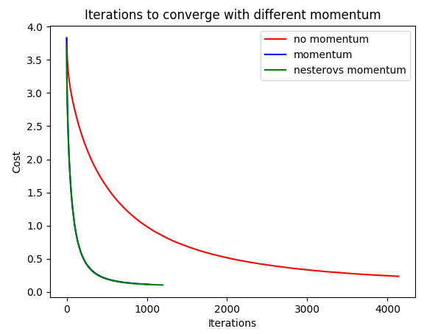

Neural Network - Momentum (with best model)
Momentum speeds up gradient descent.
Its impact is clear in the graph. A speed up of almost 4 times is achieved in training.
The best model’s scores on the test set are:
The model trained in 7 min, with nesterov’s momentum.

Slide 12

Conclusions
MLPC makes the best predictions, but takes very long.
SVC isn’t as good at predicting, but it’s much faster.
SVC can be, given it’s speed, very good to prove the feasibility of a project.

